Slide 1

FSDJ LAB( ID-202P ) Even Semester - Session 2024-25 CAR RACING GAME
SANKET PUNDHIR: 202410116100183 (TEAM LEADER)
SATYJEET KUMAR: 202410116100187 (MEMBER)
SAURABH KUMAR: 202410116100188 (MEMBER)
SANIDHYA GARG : 202410116100182 (MEMBER)
Project Supervisor:
Dr.Vipin Kumar
Associate Professor

Slide 2
Car Racing Game
Creating an Interactive Java Game with Swing and AWT

Slide 3
Introduction
This presentation explores the development of an interactive car racing game using Java Swing and AWT. It covers the implementation of responsive controls, smooth animations, and features like score tracking and collision detection to enhance the gaming experience.

Slide 4
01
Game Development

Slide 5

Java Swing and AWT implementation :
Java Swing and AWT provide the necessary tools to build the graphical user interface for our car racing game. Swing offers a rich set of widgets and controls for creating an interactive and user-friendly environment, while AWT handles the basic components of our game window. Together, they facilitate smooth graphics and responsive gameplay, ensuring players have an engaging experience.

Slide 6
Modular and scalable architecture :
A modular architecture allows the game to be easily updated and expanded. By separating different functionalities into modules, such as graphics, sound, and game logic, developers can focus on improving specific parts of the game without affecting the overall performance. This design not only facilitates easier maintenance but also enables the addition of new features, levels, and gameplay elements in the future.

Slide 7
Real-time score tracking and collision detection :
In our car racing game, real-time score tracking is essential for keeping players engaged and providing instant feedback on their performance. Implementing a scoring system requires accurate detection of collisions and checkpoints, ensuring that players know when they have achieved a new best time or made successful maneuvers. Collision detection algorithms must be precise to create a realistic environment where players can experience the consequences of their actions, enhancing the overall gameplay.

Slide 8
02
User Experience

Slide 9
Smooth animations & responsive controls :
To enhance the player experience, implementing smooth animations is crucial. These animations should transition seamlessly between various states, such as starting the race, drifting, and colliding with obstacles. Additionally, responsive controls are vital for ensuring that players feel in command of their vehicles, allowing for quick reactions and strategic maneuvers throughout the race. This combination results in a much more immersive gaming experience that keeps players coming back.

Slide 10
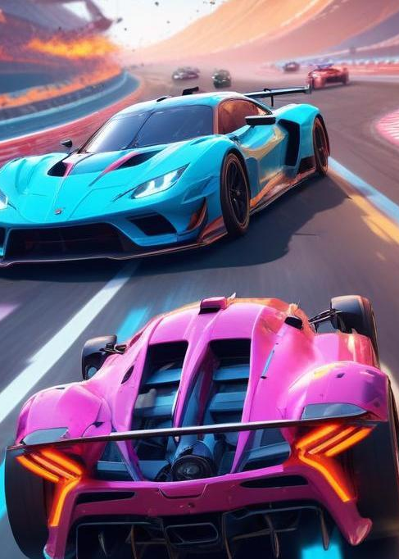
Visual interface and dynamic obstacles
A visually appealing interface enhances user engagement and keeps players interested. Incorporating dynamic obstacles, such as other racing cars or environmental challenges, creates a more exciting gameplay environment. Vivid graphics, animated elements, and intuitive layout design contribute to the overall aesthetic, making the game visually stunning while maintaining clarity and ease of use for the player.

Slide 11
Difficulty levels and player engagement
Providing various difficulty levels is essential for catering to a wide range of player skills. By allowing players to choose their difficulty, they can challenge themselves or enjoy a more casual experience based on their preferences. Engaging players through progressively challenging levels keeps the game exciting and encourages them to improve their skills, making each race feel rewarding and fulfilling.

Slide 12
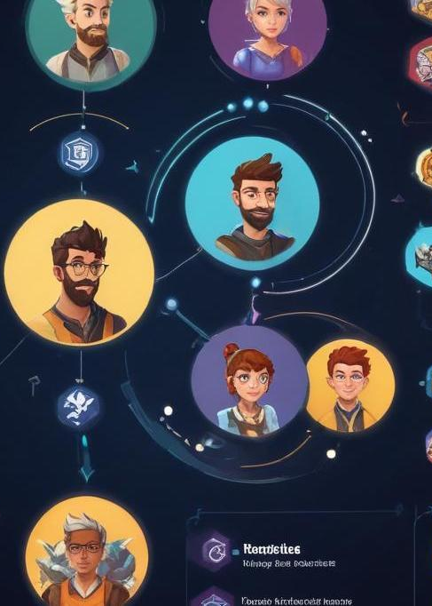
Conclusions :
Developing a car racing game involves several key components that contribute to an engaging and interactive experience. By utilizing java swing and AWT, developers can create a modular architecture with responsive controls and captivating visuals. Features such as real-time score tracking and collision detection enhance gameplay, while multiple difficulty levels ensure that all players can find a suitable challenge. Continuous focus on user experience will foster player engagement and a lasting appeal for the game.

Slide 13
THANK YOU
.

